Slide 1
Chapter 3: Fundamental Data Structures: The Array and Linked Structures
Data Structures in Java: From Abstract Data Types to the Java Collections Framework
by Simon Gray

Slide 2
Introduction
What will you use as the backing store for your collection types?
Array and linked structures have different characteristics
It is important to know these characteristics as they affect the performance of the collection using them

Slide 3
The Array Structure
Static array
  size determined at compile time
  this is limiting
Dynamic array
  Size determine at run time
  An object in Java with its own properties
  Can be resized (larger or smaller)

Slide 4
Array Characteristics
An array is a homogeneous data structure – all elements must be of the same type: this mean each cell will be the same size
The elements of an array are in adjacent memory locations
Because each cell has the same size and the cells are adjacent in memory, it is possible to compute the address of an array cell; so an array access “costs” a computation followed by a memory access
⇒ an array is a random (direct) access data structure

Slide 5
Array Operations
Traversing – can be bidirectional
Resizing – can make a new array that is smaller or larger than the original array – a θ(size of new array) operation
Replacing an element – an O(1) operation
Inserting an element – an O(n) operation due to data movement
Deleting an element – O(1) or O(n) depending on implementation

Slide 6
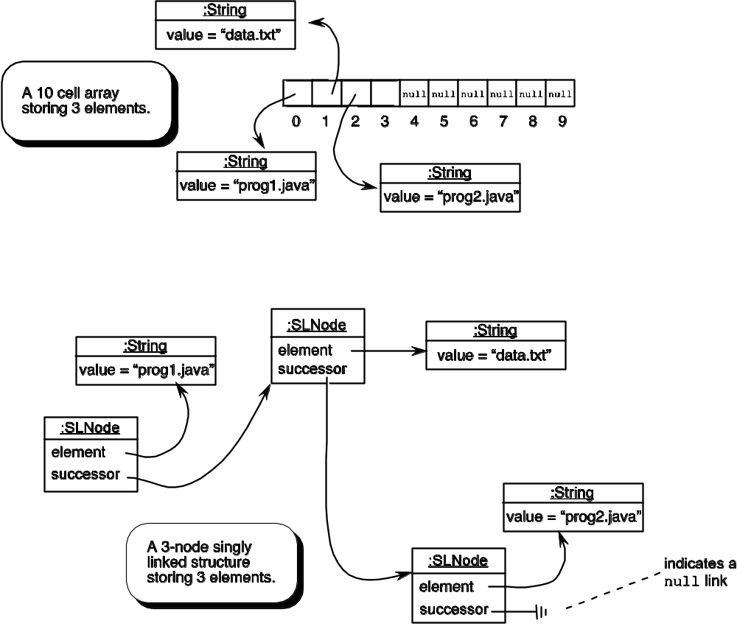
Array Versus Linked Structures

Slide 7
Linked Structure Characteristics
Nodes in a linked structure are allocated individually, so the number of nodes in the linked structure can grow and shrink as needed
The nodes of a linked structure are not necessarily adjacent in memory
Because the nodes of a linked structure are not necessarily adjacent in memory, the computer cannot calculate the address of a node as it could for a cell in an array, so each node must store the location of node in the structure – this reference is the link
⇒ a linked structure is a sequential access data structure

Slide 8
SLNode<E>
1 package sgray.ch3;
2
3 /**
4 * The structure of a node in the singly linked list
5 */
6 public class SLNode<E> {
7 private E element; // the data field
8 private SLNode<E> successor; // link to successor
9
10 /**
11 * Create an empty <tt>SLNode</tt> object.
12 */
13 public SLNode() {
14 this.element = null;
15 this.successor = null;
16 }
17
18 /**
19 * Create an <tt>SLNode</tt> that stores <tt>theElement</tt> and
20 * whose successor is <tt>theSuccessor</tt>.
21 * @param theElement the element to store in this node
22 * @param theSuccessor this node’s successor
23 */
24 public SLNode( E theElement, SLNode<E> theSuccessor ) {
25 this.element = theElement;
26 this.successor = theSuccessor;
27 }
The self-referential
(recursive) part of the definition

Slide 9
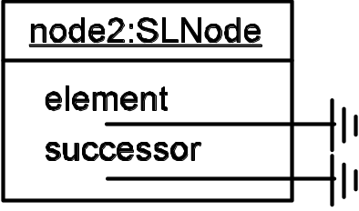
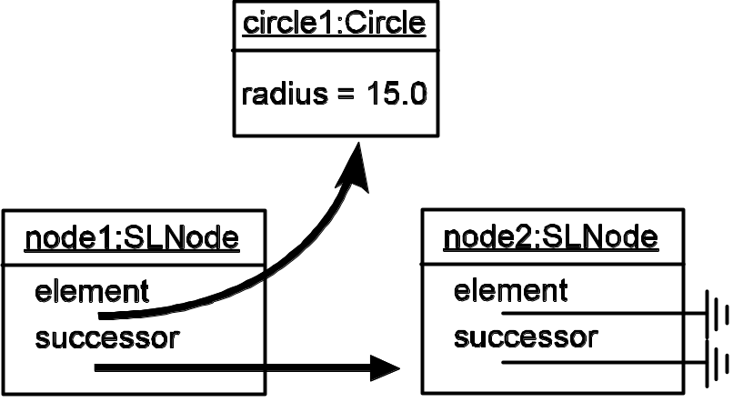
SLNode Construction
SLNode<Circle> node2 = new SLNode<Circle>();
SLNode<Circle> node1 = new SLNode<Circle>( circle1, node2 );

Slide 10
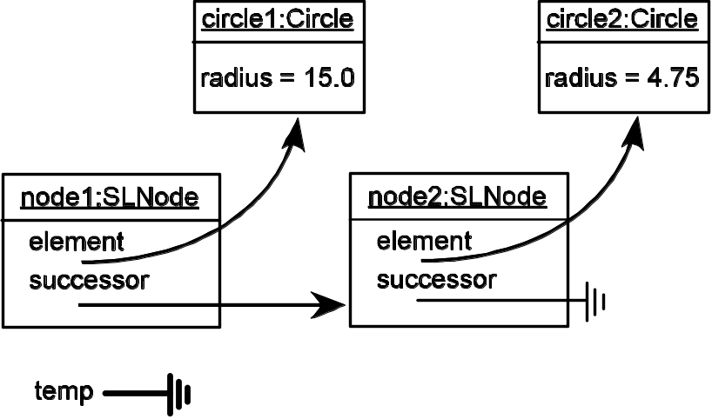
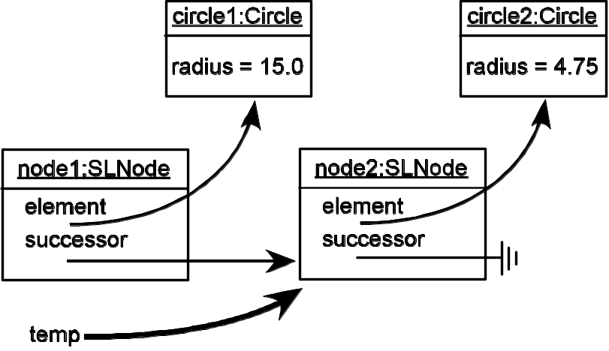
Accessing the successor
SLNode<Circle> temp = null;
temp = node1.getSuccessor();

Slide 11
A Singly-linked List using SLNode
public class SinglyLinkedList<E> {
SLNode<E> head; // access point to the linked list
SLNode<E> tail;
int length; // # data nodes in the linked list
Issue: how to represent an empty list
  This has implications for coding several of the support methods
Options:
  a null head and tail means the list is empty
  use “dummy nodes” for the head and tail

Slide 12
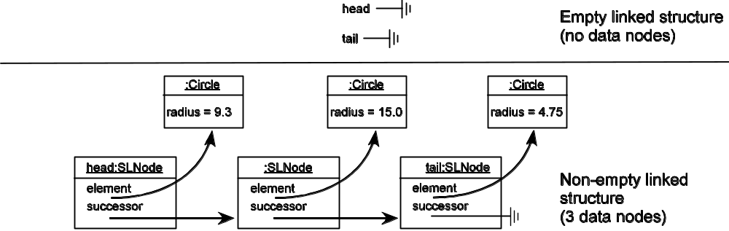
Option 1: a null head/tail Means Empty
Indicates “no
more elements”
Using head and tail as references to the
first and last nodes of a linked structure

Slide 13
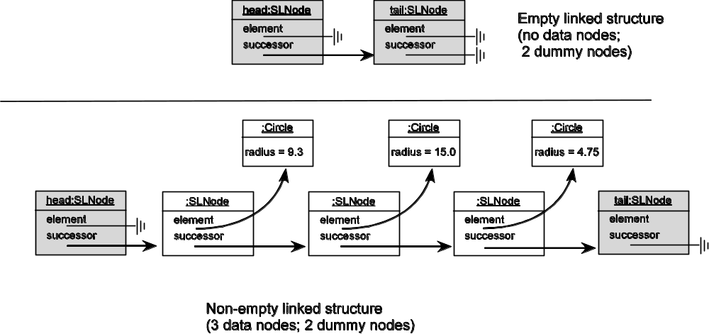
Option 2: Use dummy nodes
Indicates “no
more elements”
Using dummy nodes for the head and tail of the linked structure.
The dummy nodes are shaded.

Slide 14
Inserting an Element at the List head
indicates pseudocode
public void addAtHead(E theElement) {
1. Create the new SLNode
SLNode<E> newnode = new SLNode<E>(theElement, null);
2. Set the new node’s next field to be the same as head’s next field
newnode.setSuccessor(head.getSuccessor());
3. Set head’s next field to reference the new node
head.setSuccessor(newnode);
4. Increment length by 1
length++;
}

Slide 15
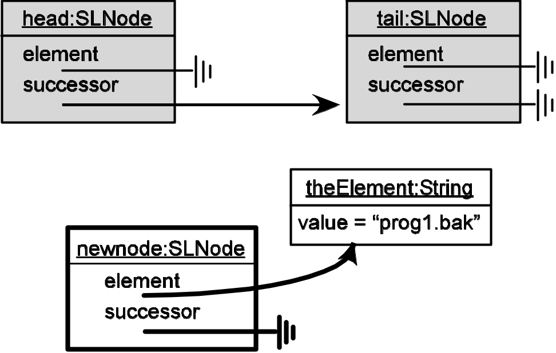
Adding at the head: Step 1 (empty list)
1. Create the new SLNode
SLNode<E> newnode = new SLNode<E>( theElement, null );

Slide 16
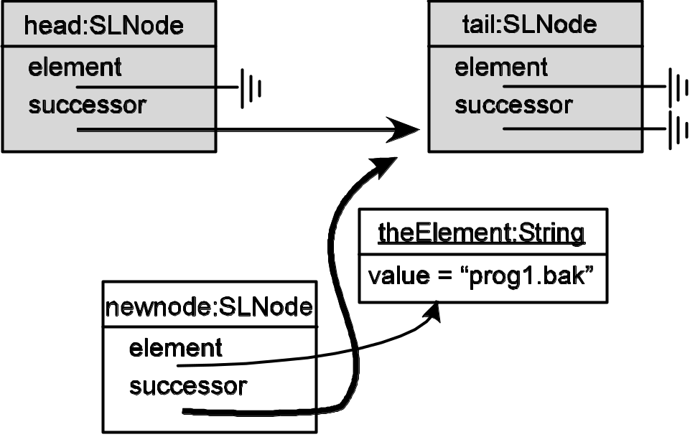
Adding at the head: Step 2 (empty list)
2. Set the new node’s next field to be the same as head’s next field
newnode.setSuccessor( head.getSuccessor() );

Slide 17
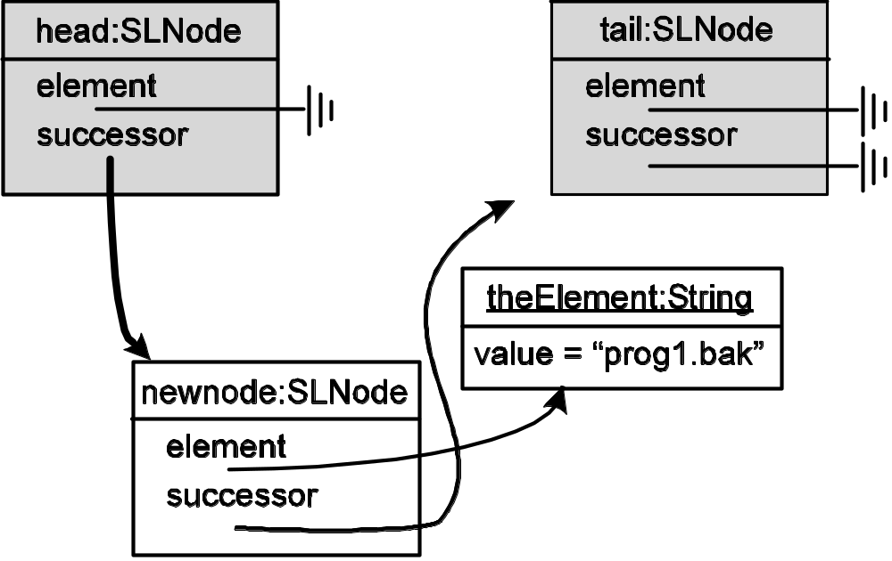
Adding at the head: Step 3 (empty list)
3. Set head’s next field to reference the new node
head.setSuccessor( newnode );

Slide 18
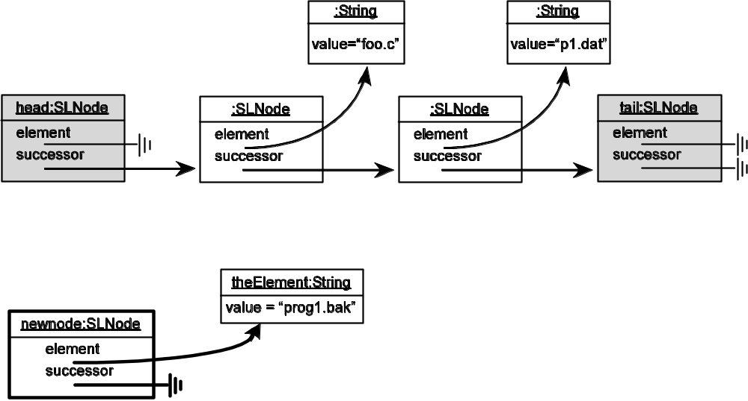
Adding at the head: Step 1 (!empty list)
1. Create the new SLNode
SLNode<E> newnode = new SLNode<E>( theElement, null );

Slide 19
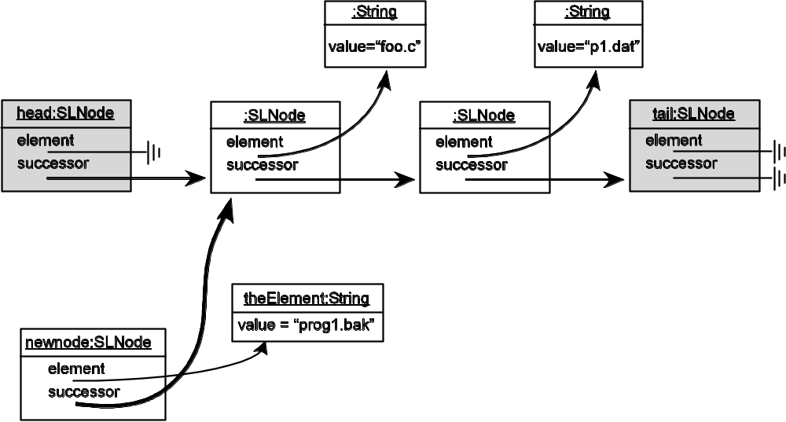
Adding at the head: Step 2 (!empty list)
2. Set the new node’s next field to be the same as head’s next field
newnode.setSuccessor( head.getSuccessor() );

Slide 20
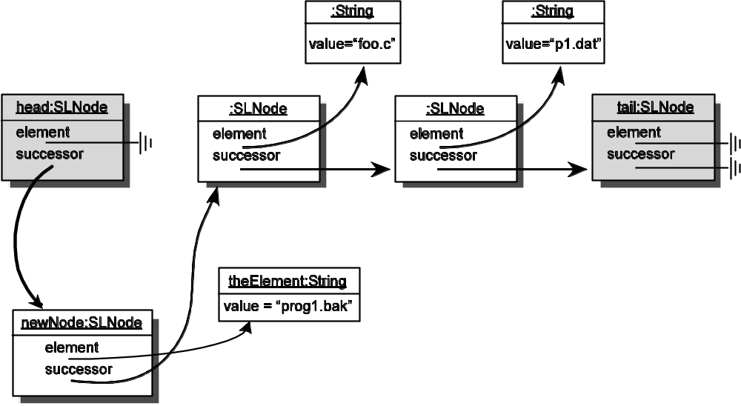
Adding at the head: Step 3 (!empty list)
Does the order of the
operations matter?
3. Set head’s next field to reference the new node
head.setSuccessor( newnode );

Slide 21
Deleting a Node: (pseudo)code
1 public E remove ( int p ) {
Verify that p is within the linked list bounds
2 if (( p < 0) || ( p >= this.length ) )
3 throw new IndexOutOfBoundsException();
Move cursor to node in position p – 1
4 SLNode<E> cursor = head; // good for p == 0
5 if ( p > 0 ) cursor = find( p - 1 );
Let target = cursor's successor; the node to remove
6 SLNode<E> target = cursor.getSuccessor();
Link cursor to target's successor
7 cursor.setSuccessor( target.getSuccessor() );
Get the target’s element
8 E element = target.getElement();
Unlink target from the linked list for garbage collection
9 target.setSuccessor( null );
10 target.setElement( null );
Decrement length
11 length--;
Return the element stored in the target node
12 return element;
13 }

Slide 22
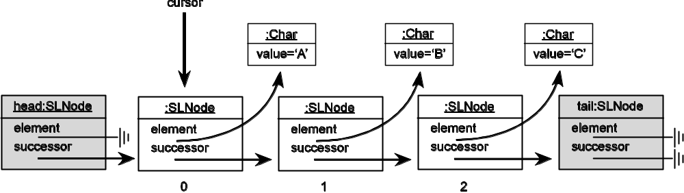
Deleting a Node: get in position
Move cursor to node in position p – 1
SLNode<E> cursor = find( p – 1 ); // for p = 1

Slide 23
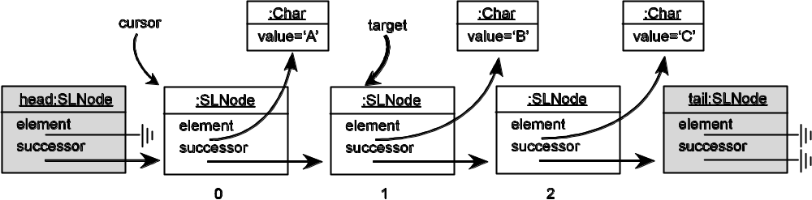
Deleting a Node: update cursor
Let target = cursor's successor; the node to remove
target = cursor.getSuccessor()

Slide 24
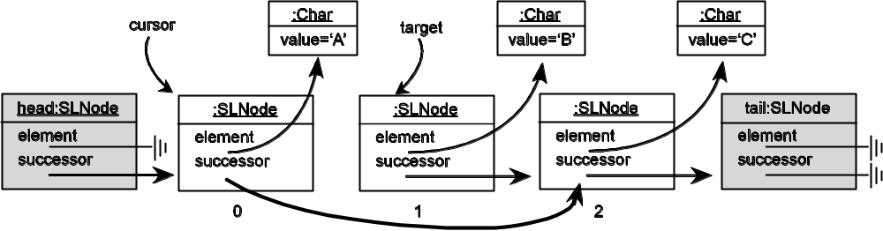
Deleting a Node: link cursor to successor
Link cursor to target's successor
cursor.setSuccessor( target.getSuccessor() )

Slide 25
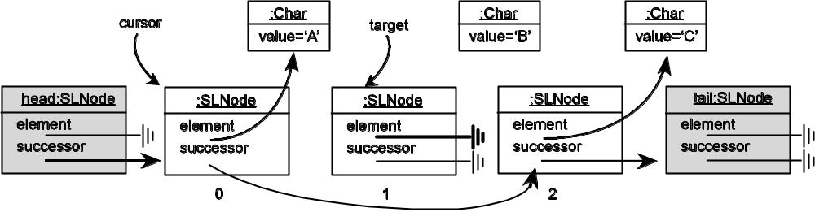
Deleting a Node: Cleanup
Unlink target from the linked list for garbage collection
target.setSuccessor( null );
target.setElement( null );

Slide 26
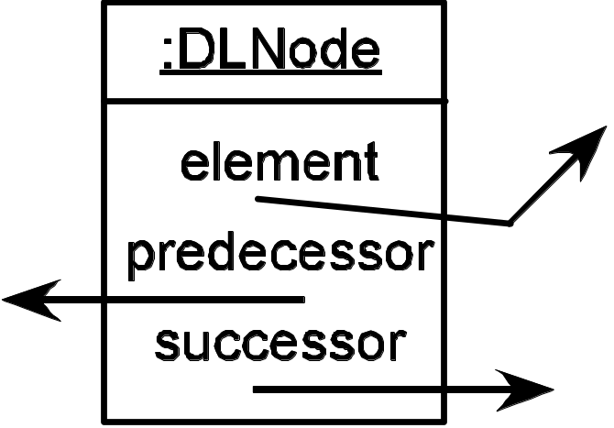
A Doubly-Linked List
The singly-linked list is unidirectional
At the expense of an additional link (and the consequent code complexity) we can have a bidirectional list
We need to add a
second “link”
attribute to the
node definition

Slide 27
Let DLNode extend SLNode
1 package gray.adts.ch3;
2
3 /**
4 * The structure of a node in the doubly linked
5 * list.
6 */
7 public class DLNode<E> extends SLNode<E> {
8 private DLNode<E> predecessor;
9
10 /**
11 * Constructor. Create an empty <tt>DLNode</tt> object.
12 */
13 public DLNode() {
14 super();
15 this.predecessor = null;
16 }
17 . . . // rest of the definition
inherit element and successor fields from SLNode

Slide 28
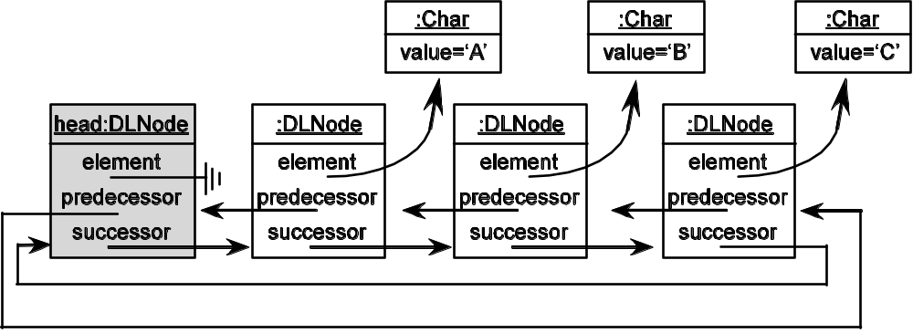
Circular Linked List

Slide 29
Time Complexity for Array Operations
Time Complexity for the Array Data Structure (n = # of occupied cells)
Operation | Cost
read (anywhere in the array) | Ο(1)
add/remove (at the logical end of the array) | Ο(1)
add/remove (in the interior of the array) | Ο(n)
resize | Ο(length of new array)
find by position | Ο(1)
find by target | Ο(n)

Slide 30
Time Complexity for Linked Operations
Time Complexity for the Linked Data Structure
Operation | Cost
 | Singly Linked | Doubly Linked
read (anywhere in the linked list) | Ο(n) | Ο(n)
add/remove (at the head) | Ο(1) | Ο(1)
add/remove (at the tail) | Ο(n) | Ο(1)
add/remove (in the interior of the structure) | Ο(n) | Ο(n)
resize | N/A | N/A
find by position | Ο(n) | Ο(n)
find by target | Ο(n) | Ο(n)

